Slide 1

Design and Implementation of DWT for EEG Signal on FPGA
Authors: Rifa Tamanna, Nazifa Tabassum, Sheikh Md Rabiul Islam
Source:2018 4th International Conference on Electrical Engineering and Information & Communication Technology (iCEEiCT)
Presented by-
Progga Labani Howlader
Roll: 1509035

Slide 2
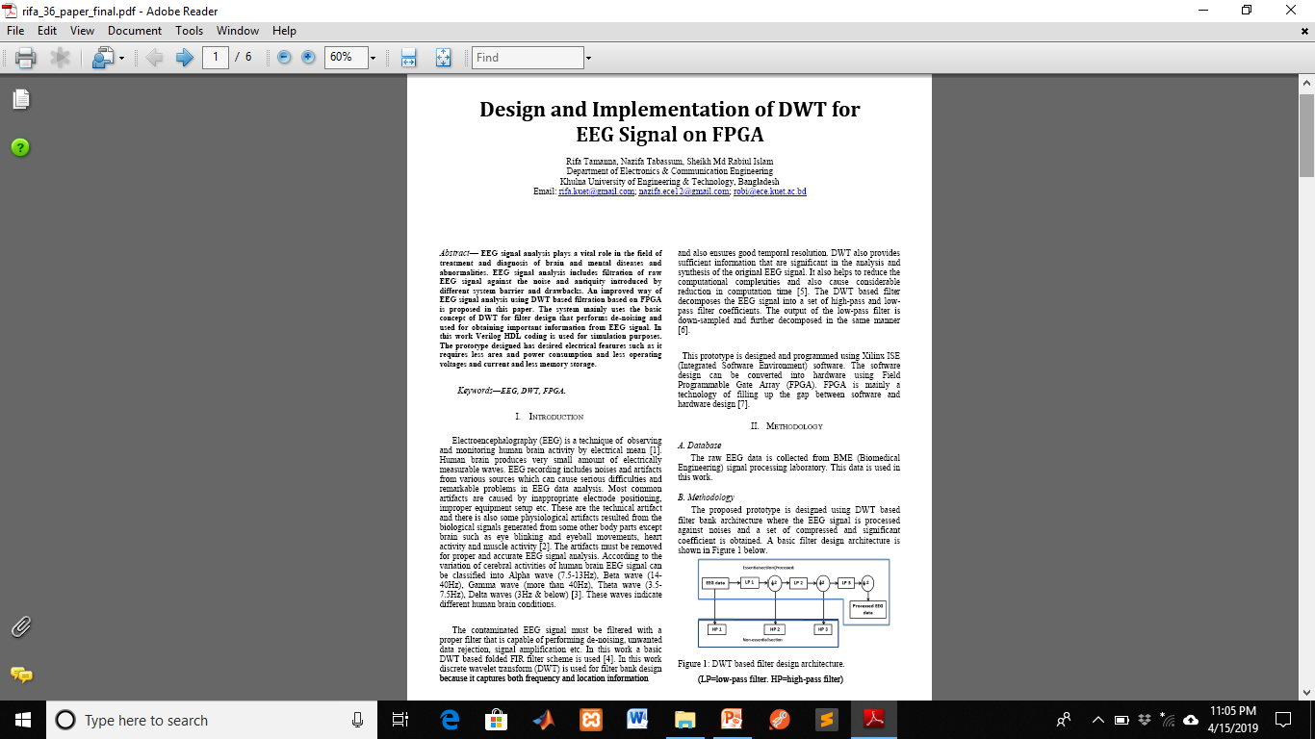

Slide 3
Overview
Background
Introduction
Methodology
Experimental observation
Result analysis
Conclusion

Slide 4
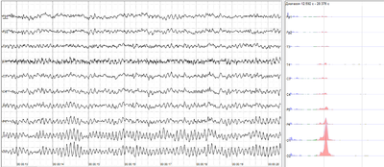
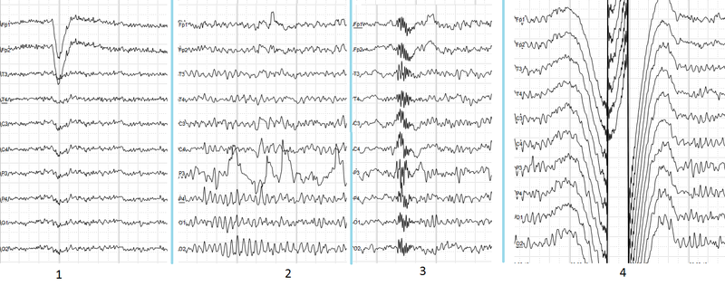
Background
Figure1:Normal EEG signal
Figure2:EEG signal with noise
EEG:
-technique of monitoring
human brain activity
- by electrical mean.
vital role
-in mental diseases
treatment.
Different system barrier and noise are included.

Slide 5
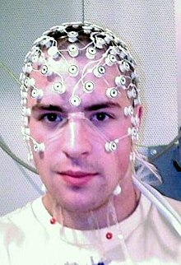

Introduction
Figure3:EEG signal recording Figure4:EEG signal analysis
FIR filter:
- DWT based folded
-used to analysis this signal
-reduces complexity and time
FPGA process:
-to convert software design to hardware
Verilog HDL code:
- use simulation purpose

Slide 6
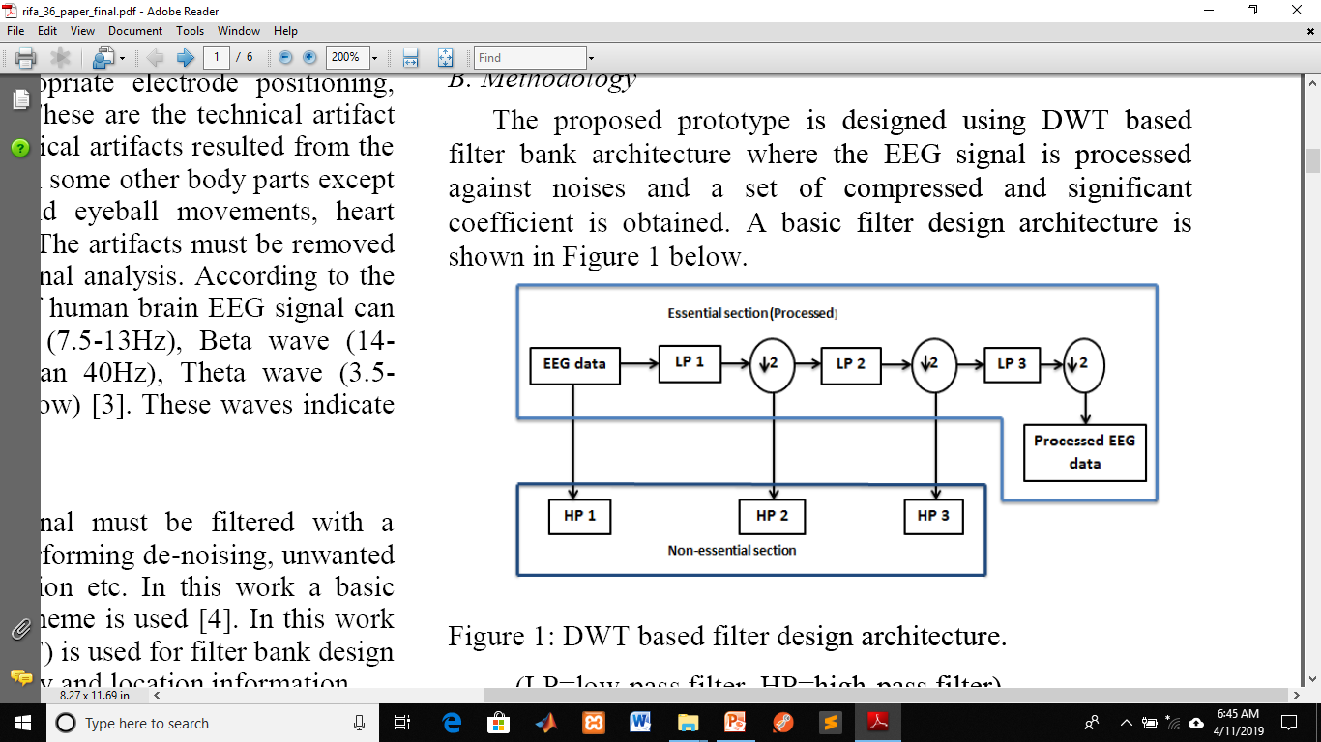
Methodology
A. Database:
The input EEG data is collected from BME signal processing lab.
B. Proposed filter design architecture:
Figure 5: DWT based filter design architecture.

Slide 7
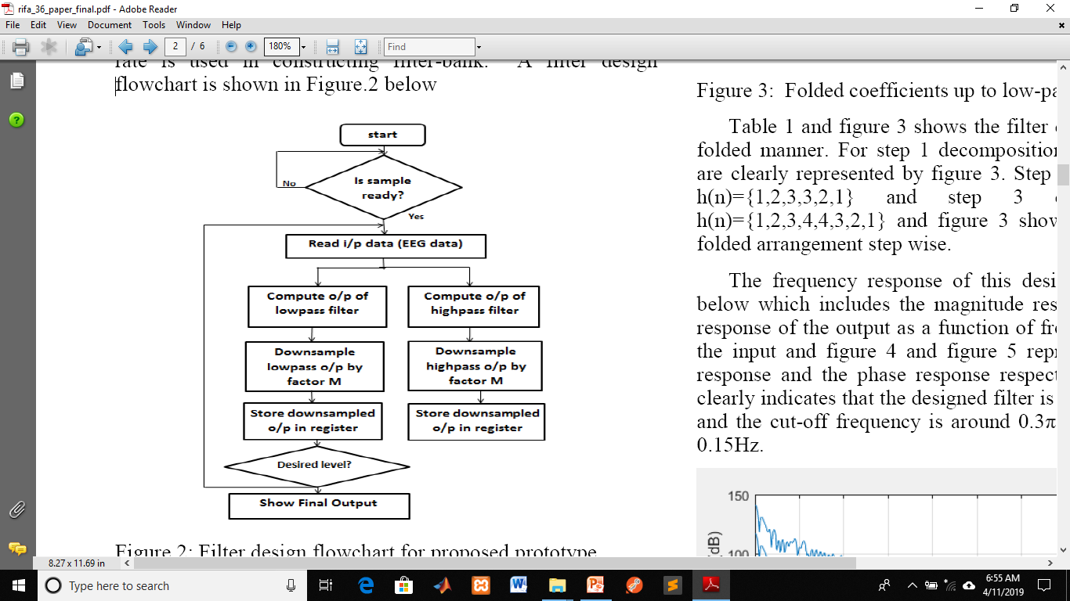
Methodology(cont..)
Figure 6: Filter design flowchart for proposed prototype.

Slide 8
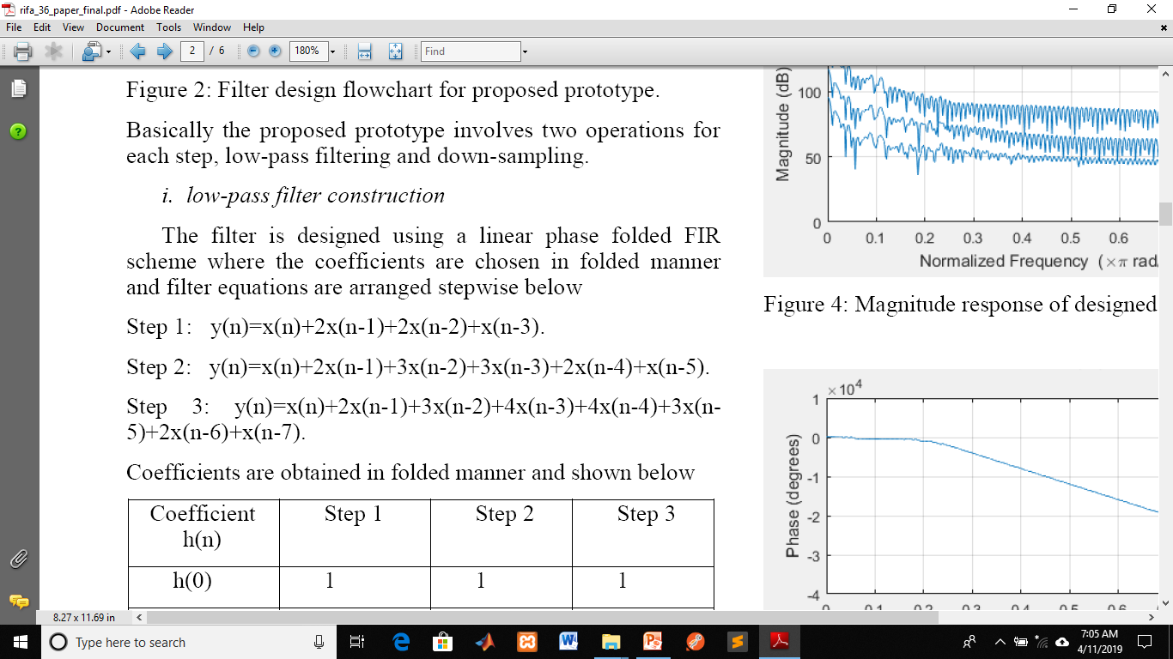
Methodology(cont..)
This proposed prototype perform 2 operations for each step
1.Low-pass filter construction :
The filter equation:

Slide 9
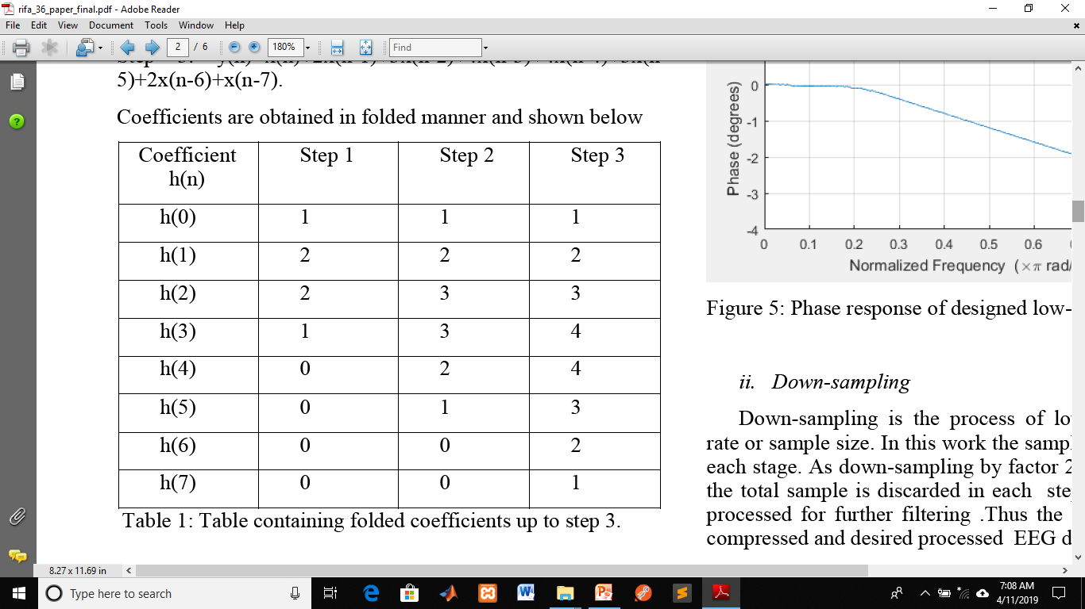
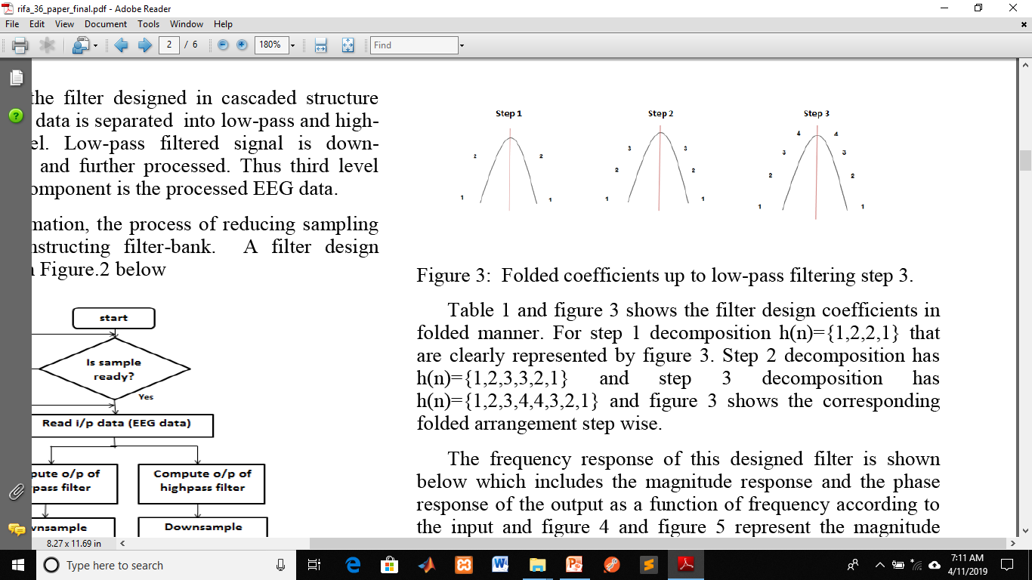
Methodology(cont..)
Table 1: Table containing folded coefficients up to step 3.
Figure 7: Folded coefficients up to low-pass filtering step 3.

Slide 10
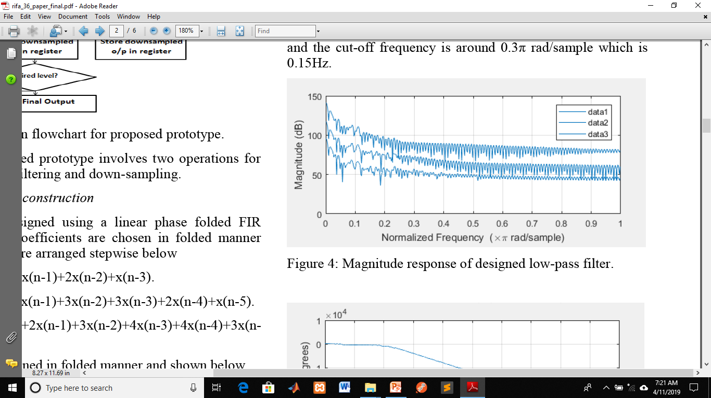
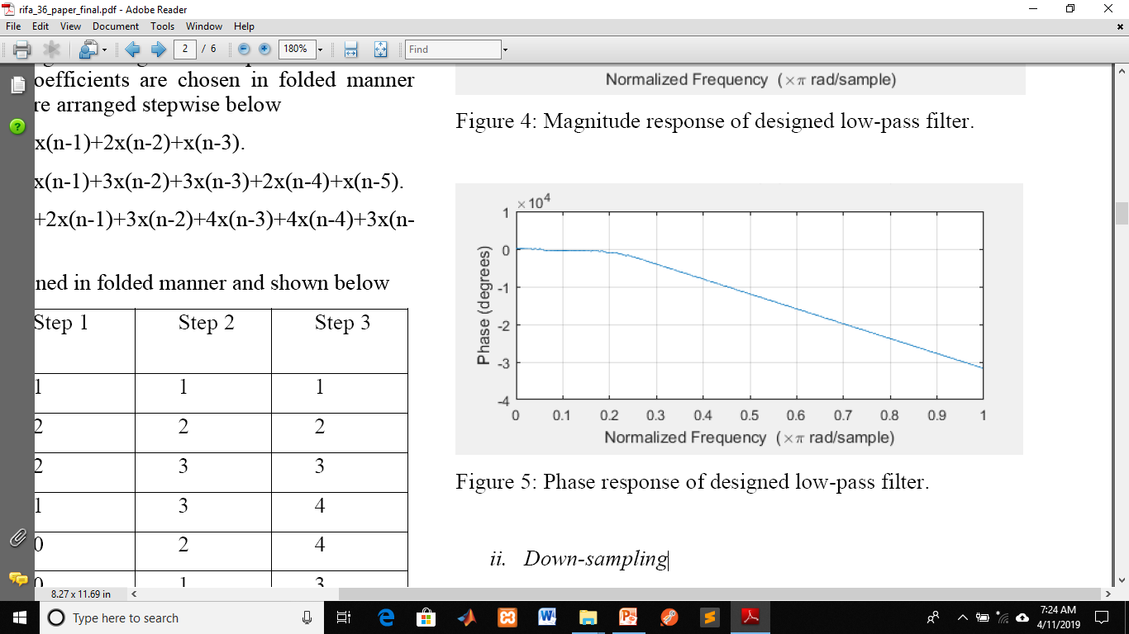
Methodology(cont..)
Figure 8: Magnitude response of designed low-pass filter.
Figure 9: Phase response of designed low-pass filter.

Slide 11
Methodology(cont..)
2.Down-sampling:
The process of lowering sampling rate or sample size.
The samples are compressed in each stage.
Thus the desired processed EEG data is obtained.

Slide 12
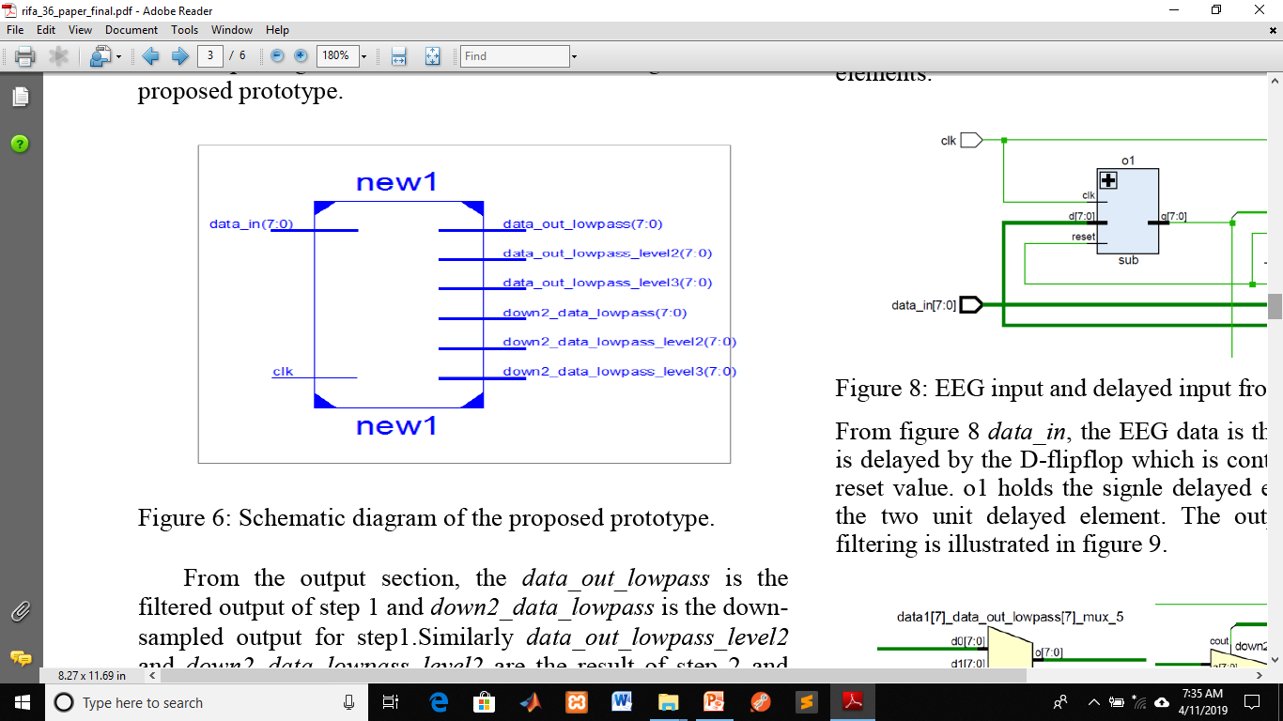
Experimental observation
A. Schematic diagram for the proposed prototype:
Figure 10: Schematic diagram of the proposed prototype.

Slide 13
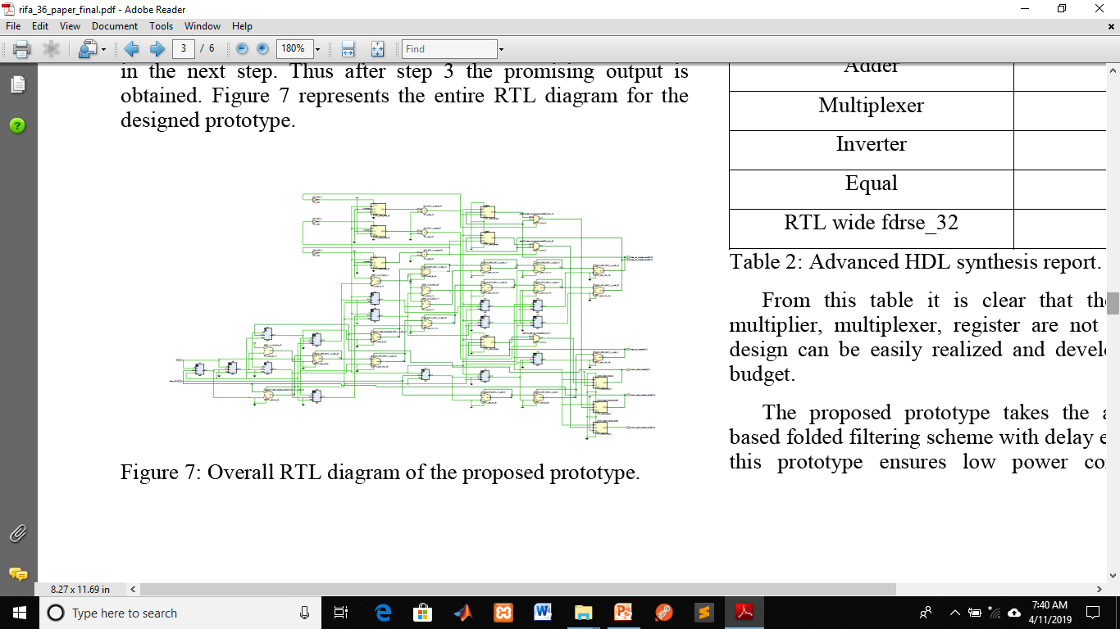
Experimental observation(cont…)
B. RTL diagram of the proposed prototype:
Figure 11: Overall RTL diagram of the proposed prototype.

Slide 14
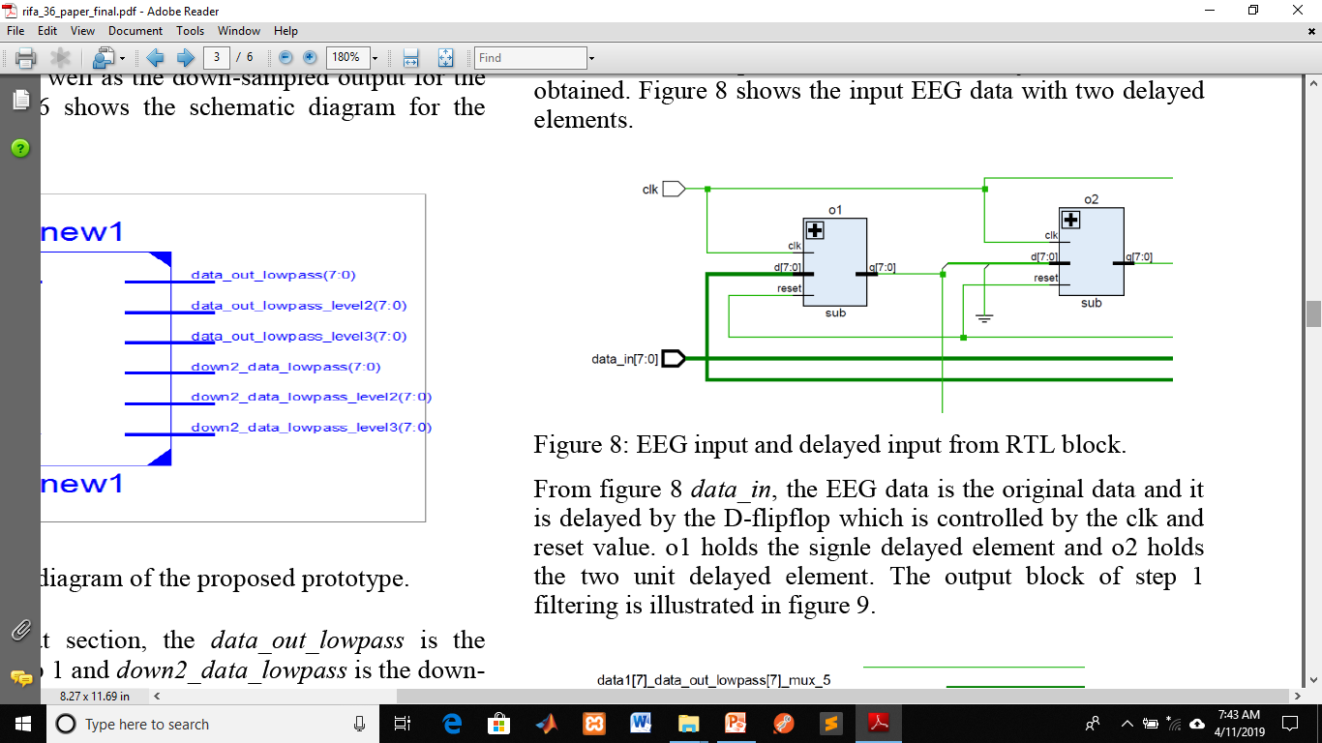
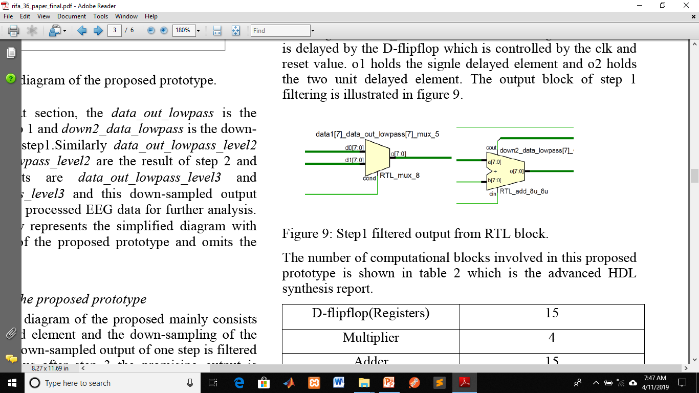
Experimental observation(cont…)
Figure 8: EEG input and delayed input from RTL block.
Figure 12: Step1 filtered output from RTL block.

Slide 15
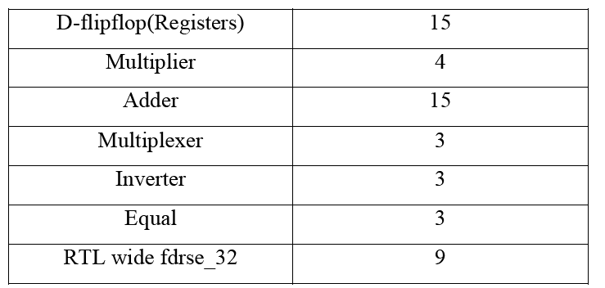
Experimental observation(cont…)
Table 2: Advanced HDL synthesis report.

Slide 16
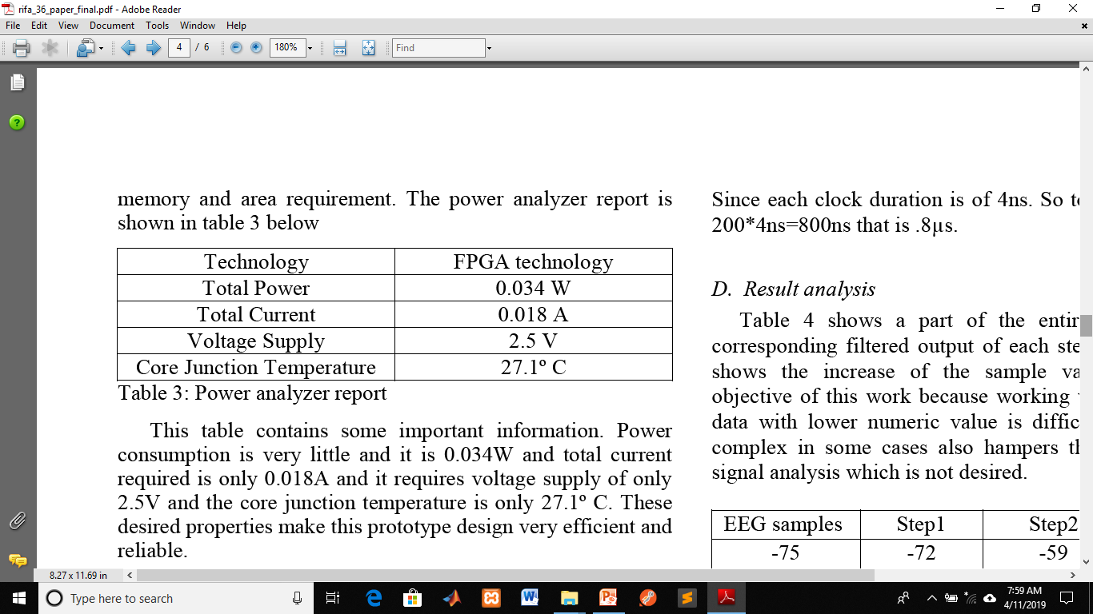
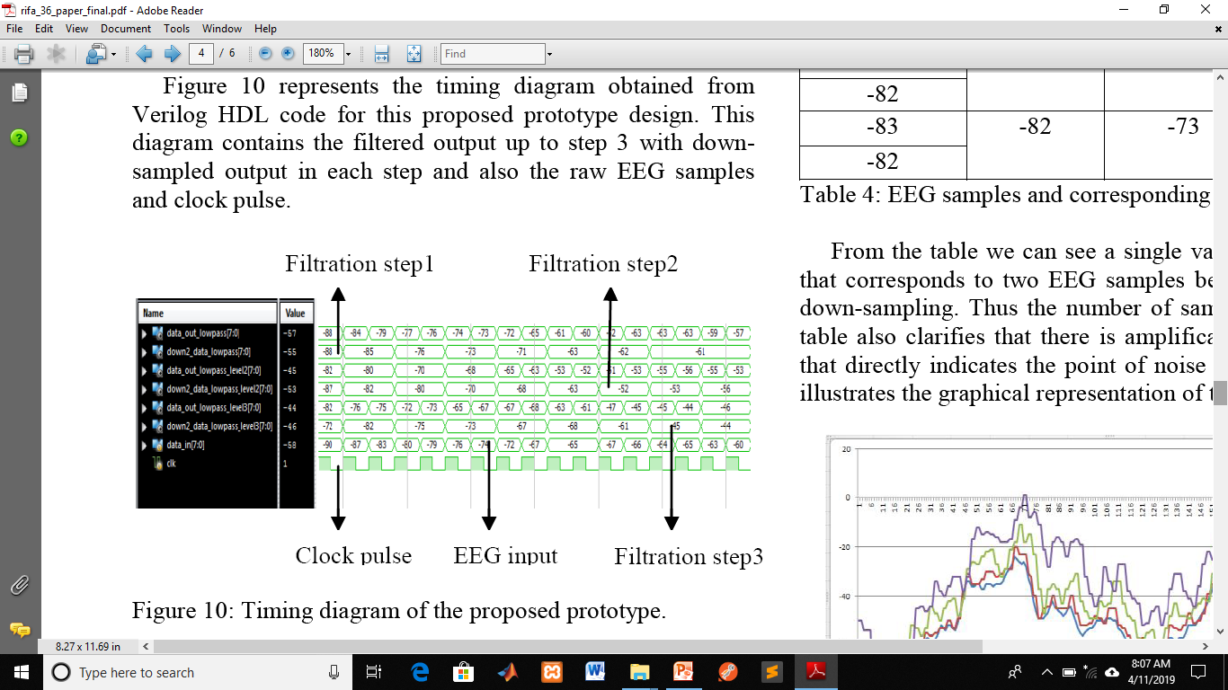
Experimental observation(cont…)
Table 3: Power analyzer report
c. Timing diagram analysis:
Figure 13: Timing diagram of the proposed prototype.

Slide 17
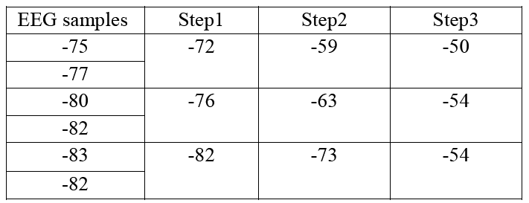
Result analysis
Table 4: EEG samples and corresponding filtered output

Slide 18
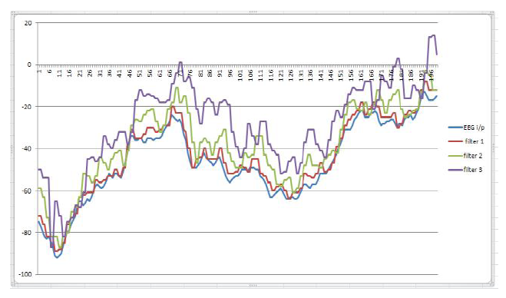
Result analysis(cont…)
Figure 14: Graph containing EEG samples and filtered output

Slide 19
Conclusion
Easy and simple approach for EEG signal analysis.
Entire filter output performs de-noising and amplification without causing distortion of the EEG signal.
Good resolution is obtained in this process.
Using Verilog code and timing diagram of Xilinx ISE software , this work is designed.

Slide 20
References
[1] N.Tabassum , S. M.R Islam, “Implementation of Biochip on Multirate System for EEG signal on ALTERA Cyclone Device”, 3rd International Conference on Electrical Information and Communication Technology (EICT), 7-9 December 2017, Khulna, Bangladesh
[2] A.G.Reddy, S. Narava, “Artifact Removal from EEG Signals”, International journal of computer application(0975-8887),volume 77-No.13, September 2013.
[3] H. K.Sawant and Z. Jalali, “Detection and classification of EEG waves”, Orient Journal of Computer Science & Technology, vol.3(1), 207-213 (June 4, 2010).
[4] A. Procházka and J. Kukal, O. Vyšata, “Wavelet Transform Use for Feature Extraction and EEG Signal Segments Classification”, Conference: Conference: Communications, Control and Signal Processing, 2008. ISCCSP 2008.
[5] Hannu Olkkonen, “Discrete Wavelet Transform-Biomedical Applications”, ISBN 978-953-307-654-6, publisher: InTech, Chapter published September 12,2011.
[6] P. M. Wai, Y. Zheng, Z, Zhao, “A 0.18-μm CMOS Multirate Filter Bank ASIC for Biomedical Applications ”, 2007 IEEE International Symposium on Integrated Circuits(ISIC 2007).
[7] C. Chou, S. Mohanakrishnan, and J. B. Evans, “FPGA Implementation of Digital Filters”, Proc. Int. Conf. Signal Proc. Appl. & Tech. (ICSPAT’93),1993.

Slide 21


